Slide 1

3.6 with Annotation configuration

Slide 2
Persistency
The process of storing data to permanent place and retrieving data from permanent place is called as persistence and such data is called as persistent data.
Add, remove, read and modify operations on persistence data are called as persistence operations and the logic used for it is called as persistent logic.
The place where data will be stored permanently is called as persistent store. As the data became permanent we can use it at any moment through programming.
Ex: - Flat files, Database soft wares etc..,
Flat files:-are normal text files where data can be stored and maintained by OS (operating system).
Ex: - *.txt files
Note1: *.java, *.c and *.cpp files are not flat files.
Note2: In java we store data in flat files using IO streams.

Slide 3
Limitations of flat files
No security for data.
File may be deleted by mistake.
Do not supports query language like sql.
Dealing with huge amount of data is quite complex

Slide 4
OR Mapping (Object Relational Mapping)
The process of mapping java class with database table, java class member variables with database table columns and making java objects representing table rows having synchronization between them is called as OR Mapping.
In OR mapping every table row will be represented by a separate java object.
Synchronization between java objects and table row means any modification in table row reflects in java object and vice versa.
To take care of this synchronization and to allow OR Mapping based persistence logic development we need ORM software.

Slide 5
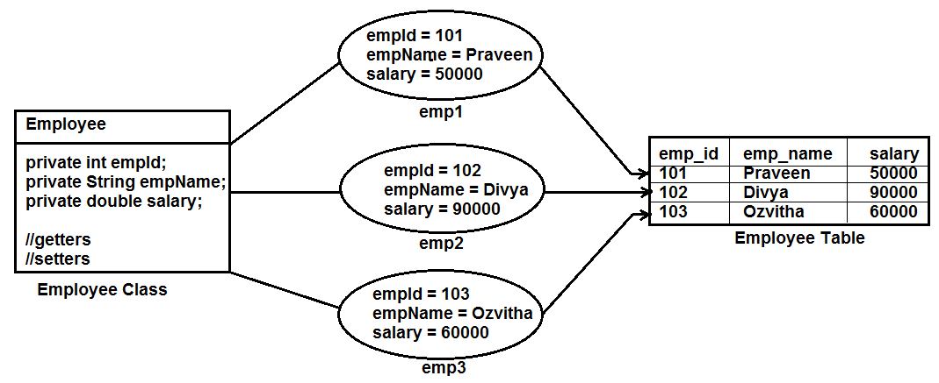
Object Relational Mapping

Slide 6
Advantages of OR Mapping
We can perform insert, delete, select and update operations on the table using java objects that are representing table rows.
Here database queries are not required. Hence OR Mapping based persistence logic becomes database independent persistence logic.
Change of database software from a running project becomes easy because there is no need of modifying persistence logic in OR mapping.
As programmer developed java class objects are representing table rows we can make these objects as serializable by making the class to implement java.io.Serializable interface.

Slide 7
List of ORM software’s
(1st Rank) Hibernate [Soft Tree]
(2nd Rank) iBatis [Apache]
(3rd Rank) Toplink [Oracle Corp.]
(4th Rank) Entity beans of EJB2.x/3.x [Sun Microsystems]
JPA [Java Persistence Api] [Sun Microsystems]
OJB [Apache]
JDO [Adobe]
Note: Ranks are given usage wide.

Slide 8
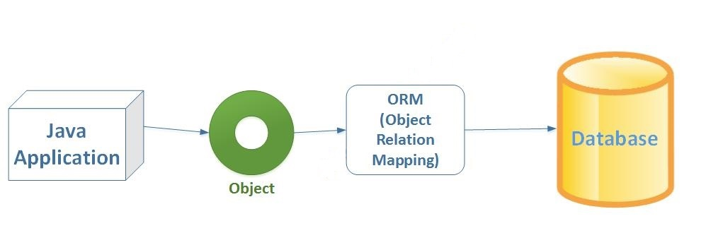
Hibernate
Hibernate is an open source, light weight ORM tool to develop DB independent persistence logic in java based enterprise applications

Slide 9
API dependent means classes and interfaces used in the application development must extend or implement one of the predefined (built in) classes or interfaces.
Ex: - Our servlet class is API dependent because it has to extend from predefined GenericServlet or HttpServlet class.
Hibernate applications are called light weight because classes and interfaces are not API dependent.
There is no need of container/web/application servers to manage hibernate applications.
Specific API: API which is used for development of only a particular kind of application. Eg: servlet api is used only for the purpose of web application development.
POJO Classes: The classes that are not API dependent are called as POJO [Plain Old Java Object] classes.

Slide 10
Hibernate
Vendor: Soft Tree
Version: 4.x [Compatible with jdk 1.5 and above
Open source software [Free software (not commercial software)]
Download software as zip file from www.hibernate.org or www.sourceforge.net
Software Developer or Author: Gavin King
Help: www.forum.hibernate.org
Documentation help: www.hibernate.org

Slide 11
Hibernate Features
Gives support for POJO/POJI model programming.
API Independent.
Light weight technology [no need of servers or containers].
Database independent persistence logic in OR-Mapping style.
No byte code enhancements like EJB.
Supports inheritance and polymorphism features. [EJB components do not support inheritance.]
Pluggable with any java/j2ee or framework software based applications.
The persistence logic of hibernate application can be access from all types of java client applications.
Gives implicit Middleware services like jdbc connection pooling, transaction management etc..,
Gives support to work with third party jdbc connection pooling.
Supports to call stored procedures and functions.
Supports database independent query language called HQL (Hibernate Query Language]

Slide 12
Supports object level relationships [Associations]
One-to-one
One-to-many
Many-to-one
Many-to-many
Uses hibernate specific data structure “Bag” which is advanced to list.
The result generated via select operations is serializable object by default.
Provides three full-featured query facilities:
Hibernate Query Language
Hibernate Criteria Query API
Native SQL
Hibernate applications are not distributed. Hence the setup of hibernate must reside with the
application/component which needs to interact with database software.

Slide 13
Hibernate configuration file
Its a xml file.
Any file name *.xml can become hibernate configuration file.
Standard name is “hibernate.cfg.xml”
Database level: It is at database level. It means for every database we can have a separate configuration file. Eg: If we are using only one database in our application then we can have only one hibernate configuration file. If we are using two databases in our application then we need to use two hibernate configuration files and so on.

Slide 14
Then we need to configure all required properties of configuration file. Then we can go for configuring all the mapping files.
This file contains hibernate properties having values that are required to establish connection with Database software and pass special instruction to database software and hibernate software.
Using these details hibernate software constructs a pool of hibernate session objects represented by hibernate session factory object.
Each hibernate session object encapsulates the functionality of jdbc connection object and statement object.

Slide 15
Properties of Hibernate Configuration file
In configuration file we need to configure the following5 properties mandatorily.
1. hibernate.dialect
2. hibernate.connection. _class
3. hibernate.connection.udriverrl
4. hibernate.connection.username
5. hibernate.connection.password
Note:
1. These properties need not to follow any sequence.
2. Driver class, url, user name & password are same like our jdbc program.
3. Dialect class:
1. Its a database specific class. It means it differs from one database to another database.
2. Dialect classes are provided by hibernate api.
3. Using dialect class our hibernate engine can know all the inner details about underlying database server. So that it can generate database specific queries at run time of program.

Slide 16
States of Persistent class object
1. Transient state:
a. Object is created by programmer with data. But it doesn’t represent any table row.
b. This object doesn’t contain primary key value.
c. The object which is created for POJO class and which is not under control of hibernate application resides in transient state.
2. Persistent state:
a. The object that represents table row with primary key and managed under the control of
hibernate software is called as persistent object.
b. This object will be in synchronization with table row.
c. Hibernate application developer’s uses this kind of object in persistent logic development.
3. Detached state
a. When session is closed automatically persistent context will be destroyed and all the objects which are in persistent state will be thrown to detached state.
b. When table row of persistence state object is deleted then object becomes detached object

Slide 17
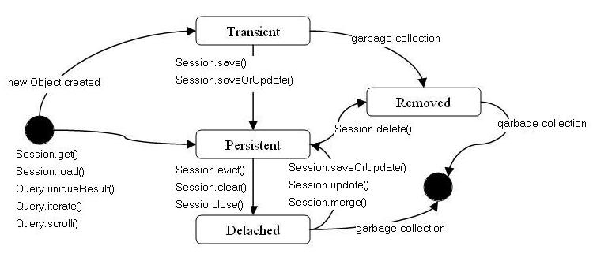

Slide 18
Hibernate application
It uses hibernate setup to interact with database software and this application is a client to database software.
It uses two important objects to represent hibernate software. They are:
1. SessionFactory
2. Session
Note: Hibernate Session object is no way related with HttpSession object of Servlet API.

Slide 19
SessionFactory
It’s an object of a class that implements org.hibernate.SessionFactory interface.
It represents connection pool.
Using this we can get session objects.
Its a thread safe object.

Slide 20
Session
Each session object of SessionFactory pool is constructed by encapsulating JDBC connection and statement objects.
Programmer uses Session object to interact with database software.
Session object is not a thread safe object.
Java Hibernate application can have multiple Hibernate Session objects.
Hibernate Session object is an object of a class which implements org.Hibernate.Session interface.
Note: Session objects of SessionFactory pool will be constructed based on Hibernate configuration file.

